Slide 1
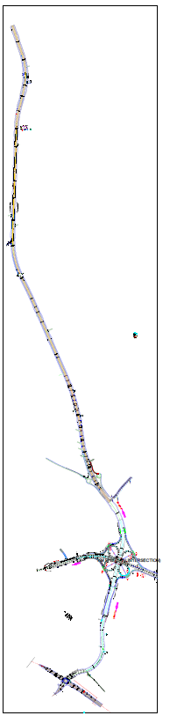
Sunyani Corridor labelling
6
5
4
3
2
1

Slide 2
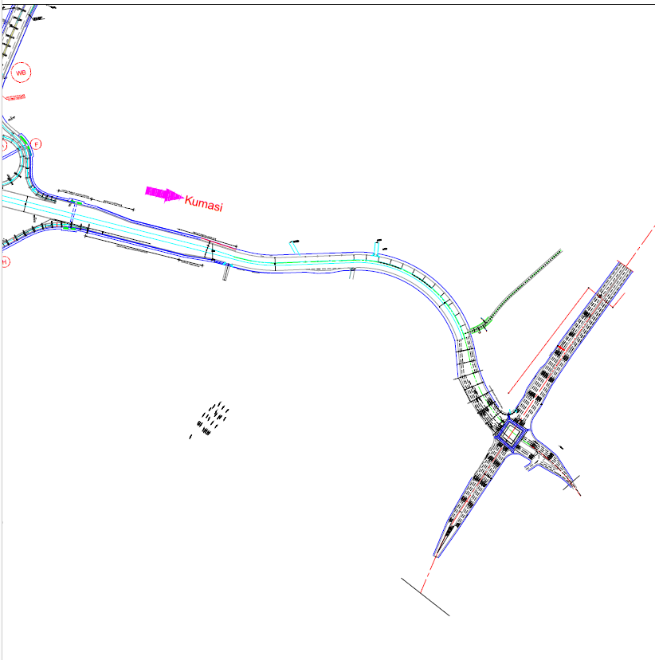
1
Sofoline Roundabout
Lighthouse Church(Bantama) Area
Bekwai Roundabout

Slide 3
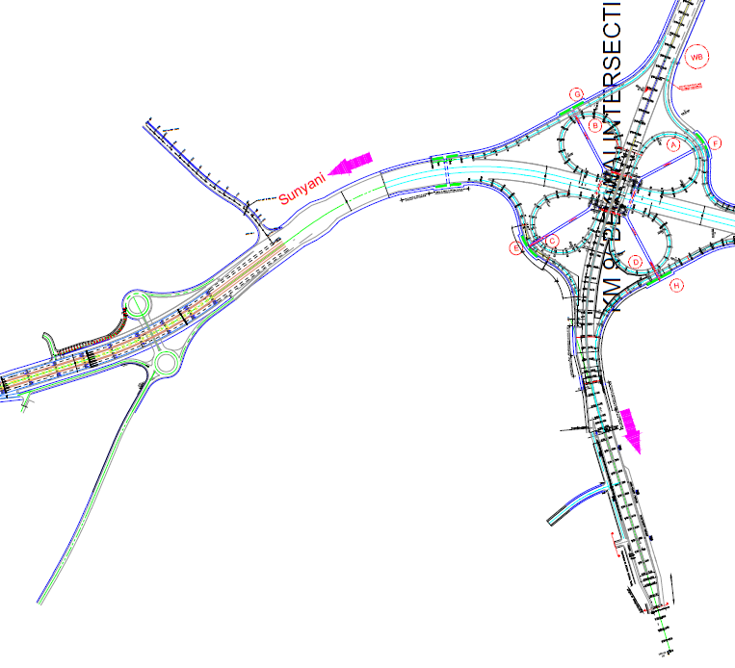
2
The Man Fast Food Service Area
Sofoline Roundabout
The Church Of Pentecost Mizpah Assembly Area
Methodist Women Training Institute Area

Slide 4
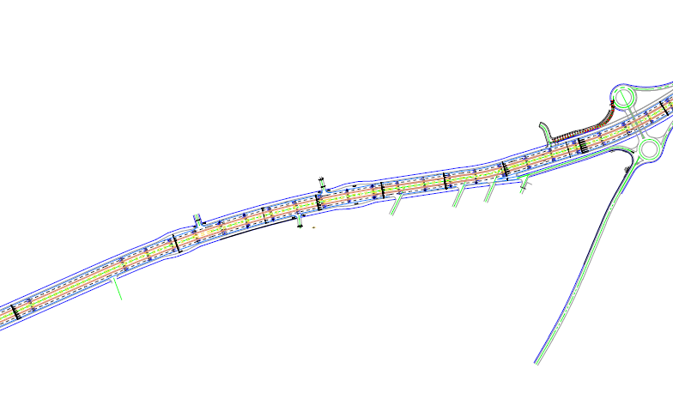
3
The Church Of Pentecost Mizpah Assembly Area
SDA Nurses Training College Area
Siloam Hospital Area
Yankee’s Pub Area
Everpure Sales Depot Area
Quality Healthcare Ltd Pharmacy Area
Morvee Food Services
Area
Universal Commodities Area
Vicande School
Area

Slide 5
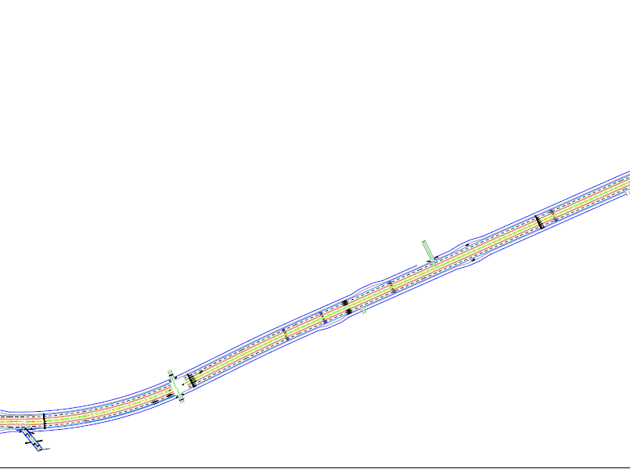
4
Shell Fuel Station
Area
Physiohub Limited
Area
Emma car diagnosing and repair shop area

Slide 6
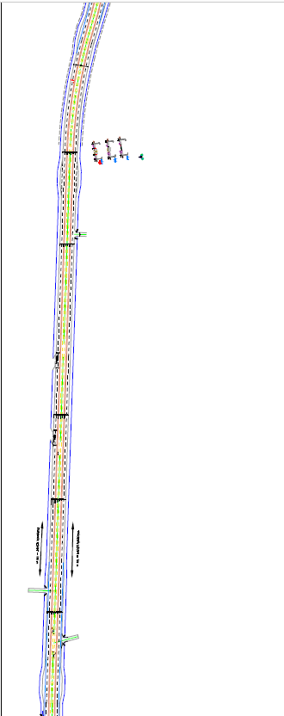
5
UEW Road
RCCG Kingdom Ambassadors
Area
Autonomy Hybrid Decoration And Training Center Area

Slide 7
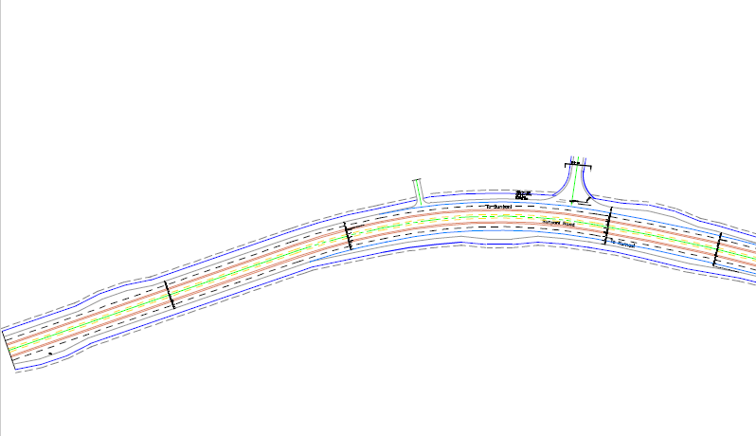
6
Apatrapa Road
Tanoso market
Area

